Slide 1
HOST BEHAVIOUR ANALYSIS
This is a project presentation on analysis of host behaviour of a property rental company by Nishant Shukla

Slide 2
Comparison of Super Hosts and Hosts
In the upcoming few slides we compare super hosts and hosts based on various matrices present in database

Slide 3
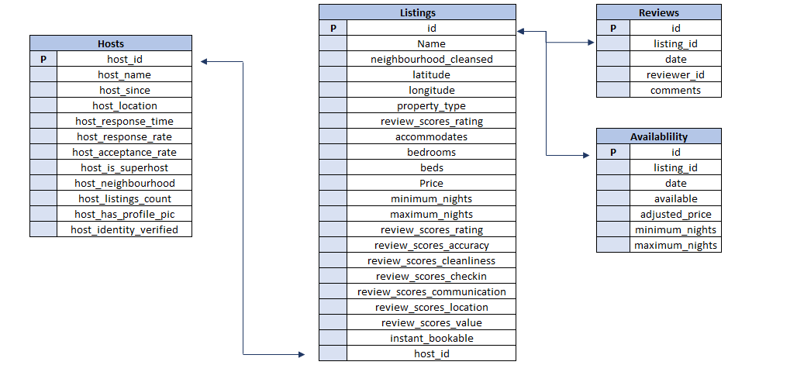
Database Schema

Slide 4
Distinction between Super host and Host

Slide 5
Insights
The graph in the previous slide gives us the percentile average of all the fields and demonstrates the distinction between Super Host and Host.
The line of Difference in the graph demonstrates the degree of Variation in matrices of comparison between Super host and Host.
From this Comparison, we come to conclusion that the most important metrics for someone to be super host is ‘Identity Verification’ followed by Average response rate and Average beds.
One insight that stands out is Super hosts have 59.82% availability while hosts have 71.85% of availability. It may be because customers prefer super hosts in comparison to hosts hence more bookings and less availability.

Slide 6
Table of Comparison
Next few slides have tables for comparison between hosts and super hosts

Slide 7
Traits | Super Host | Host | Difference | Ratio
Avg_available | 59.82142857 | 71.85185 | -12.0304 | 83.25663
Avg_price | 1.041298013 | 1.115406 | -0.07411 | 93.35595
Avg_has_profile_pic | 99.89403974 | 99.5591 | 0.334942 | 100.3364
Avg_bedrooms | 15.05896226 | 12.29583 | 2.763128 | 122.4721
Avg_scores_checkin | 98.76521428 | 95.98359 | 2.781624 | 102.898
Avg_scores_location | 96.23031646 | 93.25006 | 2.980259 | 103.196
Avg_scores_communication | 98.82658307 | 95.76994 | 3.056645 | 103.1917
Avg_review_scores_accuracy | 98.04078006 | 94.56902 | 3.471761 | 103.6711
Avg_scores_value | 96.67562219 | 92.86855 | 3.80707 | 104.0994
Avg_scores_cleanliness | 97.69587069 | 93.57872 | 4.117153 | 104.3997
Avg_review_scores_rating | 97.44971701 | 92.21416 | 5.235558 | 105.6776
Avg_instant_bookable | 73.21854305 | 65.88096 | 7.337587 | 111.1376
Avg_acceptance_rate | 95.24283352 | 87.62714 | 7.615693 | 108.691
Avg_beds | 13.56450535 | 4.873392 | 8.691114 | 278.3381
Avg_response_rate | 99.28236292 | 89.91173 | 9.370631 | 110.422
Avg_identity_verified | 85.69536424 | 66.20315 | 19.49221 | 129.443

Slide 8
Traits | Host | Super Host
Avg_response_rate | 89.91173184 | 99.28236292
Avg_acceptance_rate | 87.62714097 | 95.24283352
Avg_has_profile_pic | 0.995590978 | 0.998940397
Avg_identity_verified | 0.662031541 | 0.856953642
Avg_accommodates | 3 | 3
Avg_bedrooms | 1.475500092 | 1.505896226
Avg_beds | 2.144292396 | 2.170320856
Avg_price | 89.2324911 | 83.30384106
Avg_minimum_nights | 3 | 2
Avg_review_scores_rating | 4.61070793 | 4.87248585
Avg_review_scores_accuracy | 4.728450935 | 4.902039003
Avg_scores_cleanliness | 4.678935878 | 4.884793534
Avg_scores_checkin | 4.799179494 | 4.938260714
Avg_scores_communication | 4.788496891 | 4.941329154
Avg_scores_location | 4.662502875 | 4.811515823
Avg_scores_value | 4.643427594 | 4.83378111
Avg_instant_bookable | 0.658809564 | 0.73218543
Avg_available | 0.718518519 | 0.598214286
This table Presents the average Value of all traits of Super hosts and Hosts

Slide 9
Avg Value chart

Slide 10
Insights
From the previous graph we can observe that average response rate and acceptance rate of Super hosts are higher than Normal hosts and average cost is less. Almost all the rest of matrices are same.

Slide 11
Comparison of Comments

Slide 12
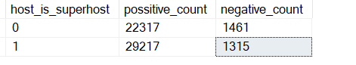
Good vs Bad
The keyword ‘good’ was used more in Super host reviews than was in Host reviews
The keyword ‘Bad’ was used more in Host reviews than in super host reviews

Slide 13
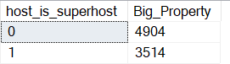
Analysis of Property type of Super hosts and Hosts
The Super Hosts tend to have smaller Properties in Comparision to Hosts as is shown by the result of analysis.
The keyword used here to identify this pattern is ‘Entire’

Slide 14
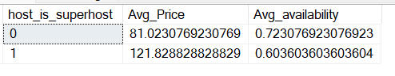
Analysis of Avg price and Availability bn super hosts and Hosts for year 2022
Avg price for Normal hosts for year 2022 is $81 while for Super hosts, it is $121.8.
Avg Availability of Normal Hosts is 72.32 % while avg availability of Super Hosts is 60.36% for year 2022.

Slide 15
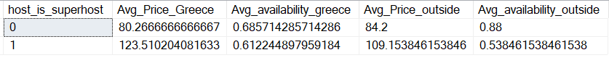
Analysis of trend in Price and availability between Local Hosts or Hosts residing in other locations for year 2022
The avg price and avg availability of listings for hosts residing outside is more than that of those residing inside Greece while it is vice versa for superhosts.

Slide 16
Thank you
Nishant Shukla
Pd13_003

